Slide 1
Computer Networks _22CS008
Controlled Access Protocols
Lecture (46-47)
Prepared By
Dr. Kiran Deep Singh
Department of Computer Science and Engineering,
Chitkara University, Punjab

Slide 2
Index
Controlled Access Protocols
Types of Controlled Access Protocols
Reservation
Polling
Token Passing
Piggybacking

Slide 3
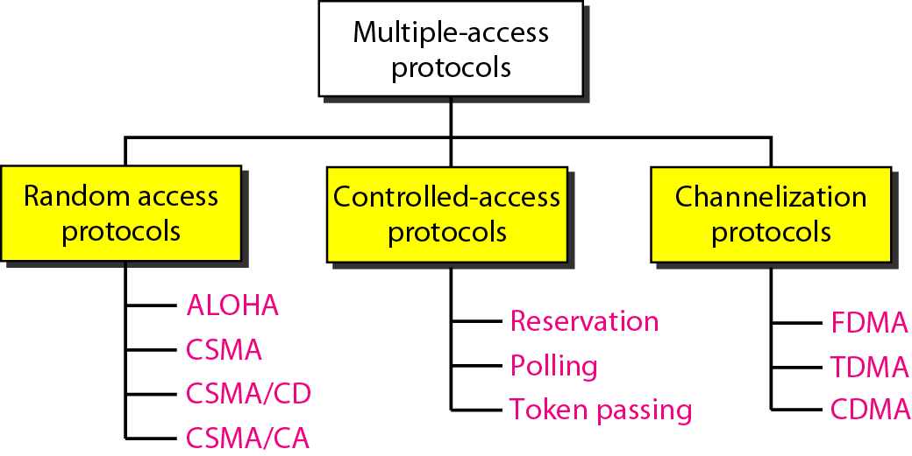
Controlled Access Protocols

Slide 4
Controlled Access Protocols
In controlled access, the stations consult one another to find which station has the right to send. A station cannot send unless it has been authorized by other stations.
Multiple devices share a single communication channel (wired or wireless).
Uncontrolled access leads to data collisions, corrupting messages.
Controlled access protocols establish order for data transmission.
These protocols ensure efficient and orderly data transmission on shared communication channels, preventing collisions and maximizing network performance. There are three primary types of controlled access protocols:
Reservation,
Polling, and
Token Passing.

Slide 5
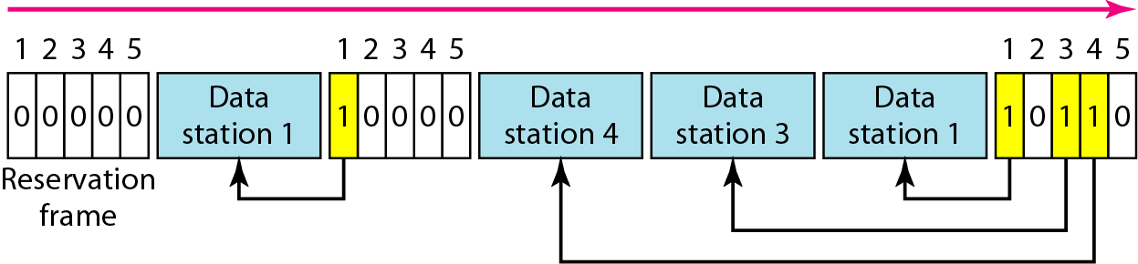
Reservation Access Method
In the reservation method, stations make reservations before sending data. Each station has a dedicated slot in the reservation interval.
Divides time into slots.
Devices reserve slots for data transmission.
Figure 1: Reservation access method.

Slide 6
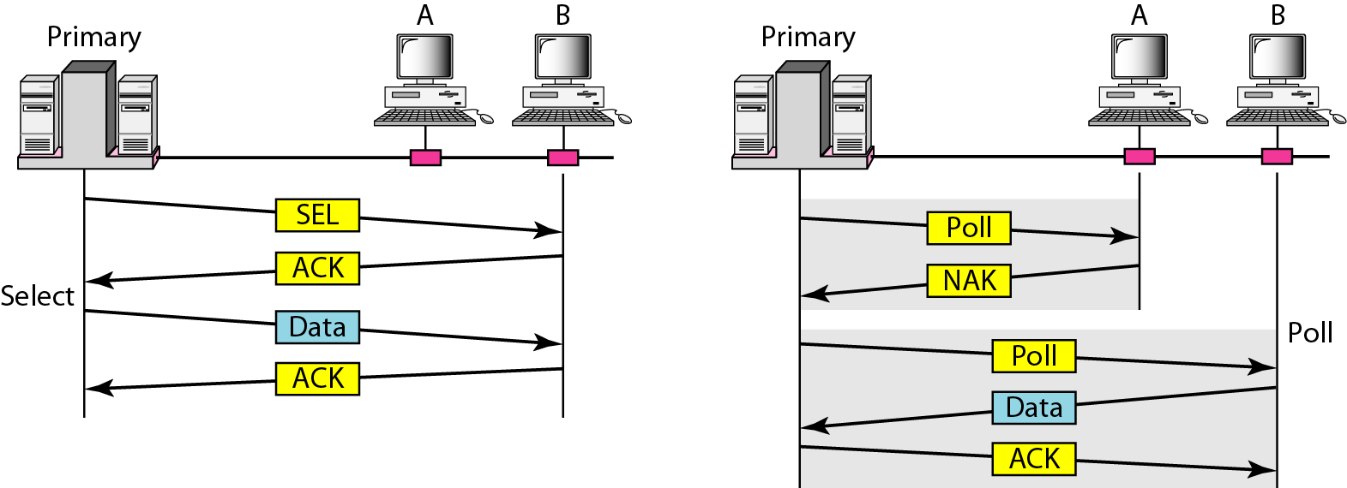
Polling Method
In polling, a central controller (master station) queries each station to check if it has data to send.
Figure 2: Select and poll functions in polling access method.
.

Slide 7
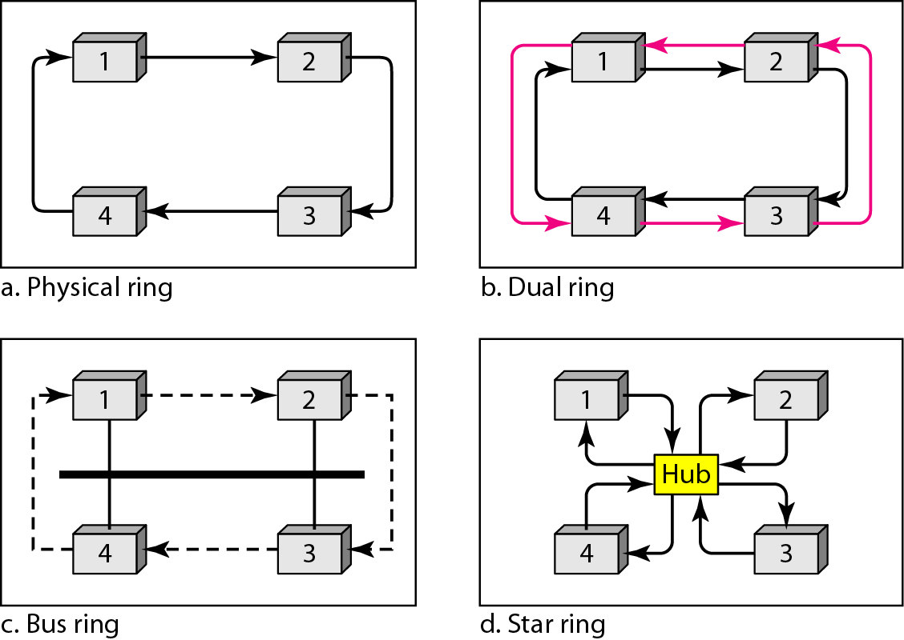
Token Passing Method
Token passing involves stations taking turns transmitting data using a token.
Figure 3: Logical ring and physical topology in token-passing access method.

Slide 8
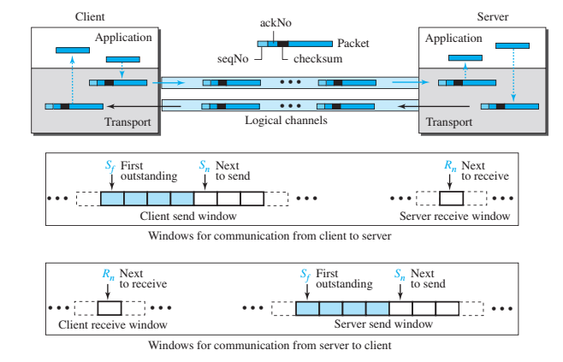
Piggybacking
Piggybacking improve network efficiency by attaching acknowledgments (ACKs) to the next data packet instead of sending them separately. When a data frame arrives, the receiver waits before sending the ACK and instead attaches it to the next outgoing data packet.
Advantages:
Better utilization of available bandwidth, as ACK frames do not need to be sent separately.
Reduced usage costs and improved latency of data transfer.
Figure 4: Piggybacking combines data and acknowledgment frames to optimize channel usage.

Slide 9
Practice Questions
In which controlled access protocol does a device reserve a time slot on the channel before transmitting data?
Polling(b) Token Passing(c) Reservation d) Piggybacking
Reservation: Devices reserve a time slot before transmitting, avoiding collisions but requiring
A central device in a network controls access to the channel by asking each device if it has data to send. This describes:
(a) Reservation(b) Token Passing(c) Polling (d) Piggybacking
Polling: A central device asks each device if it has data, ensuring orderly communication but introducing overhead
In a token passing scheme, devices can only transmit data when they are in possession of a special token. This protocol is:
Reservation(b) Token Passing (c) Polling(d) Piggybacking
Token Passing: Devices hold a token for transmission, preventing collisions and offering fair access.

Slide 10
References
https://pinoybix.org/2017/07/mcq-in-network-layer-internet-protocol-forouzan.html
https://edurev.in/course/quiz/attempt/-1_Test-Ipv4--IP-Packet/0decdb37-7206-4824-afdd-d47013a5c4cd
https://www.geeksforgeeks.org/controlled-access-protocols-in-computer-network/

